Slide 1
Chapter 11-13
Compiling C to Assembly – the Run-time Stack
计算机系统概论
Introduction to Computing Systems
（CS1002A.03）
苗付友
mfy@ustc.edu.cn
2025 Fall
计算机科学与技术学院
School of Computer Science and Technology

Slide 2
Outline
1
1
Review
Review
2
2
From ENIAC to the Stored Program Computer
Assembly Language Overview
3
3
A Machine Structure：von Neumann Model
Assembly Process
4
4
Summary
Summary

Slide 3
Problem Transformation
- levels of abstraction
How do user programs get executed?
Translation from C to Assembly
Scope of variables
Function calls
Recursion
Pointers & Arrays
Data Structures
Memory Allocation
Natural Language
Algorithm
Program
Machine Architecture
Micro-architecture
Logic Circuits
Devices

Slide 4
Programming Languages
Assembly language is low-level.
It exposes machine instructions and details of the ISA to the programmer.
It is ISA-specific.（Instructions, Memory, Registers）
It is useful when the programmer needs fine-grained control of instruction flow and memory usage.
A high-level language provides a computational abstraction that is machine-independent.
    Symbolic names (variables) instead of registers and memory locations.
    High-level operators: multiply, divide, shift, ...

Slide 5
Why use a High-Level Language? …our choice= C
Expressiveness: say more with less effort, closer to human-level thinking
 | AND R2,R2,#0
 | AND R3,R3,#0
 | LDR R0,R5,#-1 | ; b
 | BRz L3
 | BRp L1
 | NOT R3,R3 | flag=11111111
 | NOT R0,R0
L1 | ADD R0,R0,#1 LDR R1,R5,#-2 | ; c
 | BRz L3
 | BRp L2 NOT R3,R3 | flag=11111111 乘积为负
 | NOT R1,R1
L2 | ADD R1,R1,#1
 | ADD R2,R2,R0 | ; b * c
 | ADD R1,R1,#-1
 | BRp L2 ADD R3,R3,#0
 | BRz L3 | flag=00000000 乘积为正
 | NOT R2,R2
 | ADD R2,R2,#1
L3 | STR R2,R5,#0 | ; store to a
a = b * c;
C statement
Equivalent LC-3 code
a
←R5
R0←
b
R1←
c

Slide 6

The Evolution of Programming
Machine Assembly Language Language (binary)
C
Java Python Haskell What’s
Next??
Simula/C++/etc

Slide 7
Quick Note: Compilation vs. Interpretation
Different ways of translating high-level language
Interpretation (LISP, Java, Python, Matlab…)
  interpreter = program that executes program statements (generally one line/command at a time)
    Called a Virtual Machine
  easy to debug, make changes, view intermediate results
Compilation (C, C++, Pascal,…)
  translates statements into machine language
    does not execute, but creates executable program
  performs optimization over multiple statements
Example:
X = W+W
Y = X + X
Z= Y + Y
Interpreted language: 3 instructions
Compiler optimized code: 1 instruction Z = 8*W

Slide 8
Compiling a C Program
Entire mechanism is usually called the “compiler”
Preprocessor
  macro substitution
  conditional compilation
  “source-level” transformations
    output is still C
Compiler
  generates object file
    machine instructions
Linker
  combine object files
  (including libraries)
  into executable image
C Source and Header Files
C Preprocessor
Preprocessed source code
Compiler
Source Code Analysis
Symbol Table
Target Code Synthesis
Object module
Library Files
Object Files
Linker
Executable Image

Slide 9
Linking, Loading,…Makefiles
Linking: produce final executable program by combining other code (libraries) used by program
  Dynamic Linking: instead of linking at compile time the linking is done at run-time
Multi-file development….Makefiles assist in this
  Read tutorials on makefiles
Loader: load executable image generated by linker & execute
  Part of Operating system
  Memory management system does the actual mapping from user space to physical addresses
    .ORIG x3000 refers to user space x3000

Slide 10
Compiler
Source Code Analysis….you will learn the theory/foundation behind this in Foundations of Computing course
  “front end”: parses programs to identify its pieces
    variables, expressions, statements, functions, etc.
  depends on language (not on target machine)
Code Generation… we will cover it implicitly in this course
  “back end”: generates machine code from analyzed source
  may optimize machine code to make it run more efficiently
  very dependent on target machine
  We will play the role of the code generation component as we discuss how different C concepts are implemented in LC3
    This is what the compiler backend does
Symbol Table
  map between symbolic names and items
  like assembler, but more kinds of information

Slide 11
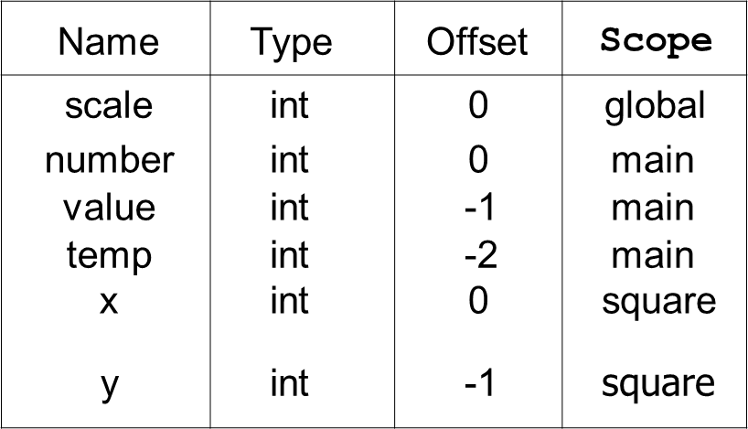
A Simple C Program
#include <stdio.h>
#define STOP 0
int scale=10;
int square(){ /* function square */{
int x,y; /* two local variables */
x = scale*scale;
return(x);}
/* Function: main */
/* Description: gets value and squares it */
main()
{ /* variable declarations */
int number, value, temp; /* three integer local variables */
/* prompt user for input */
printf("Enter a positive number: ");
scanf("%d", &value); /* read into value */
/* scale input and print */
number = value*square();
printf(”number is %d\n", number);
}

Slide 12
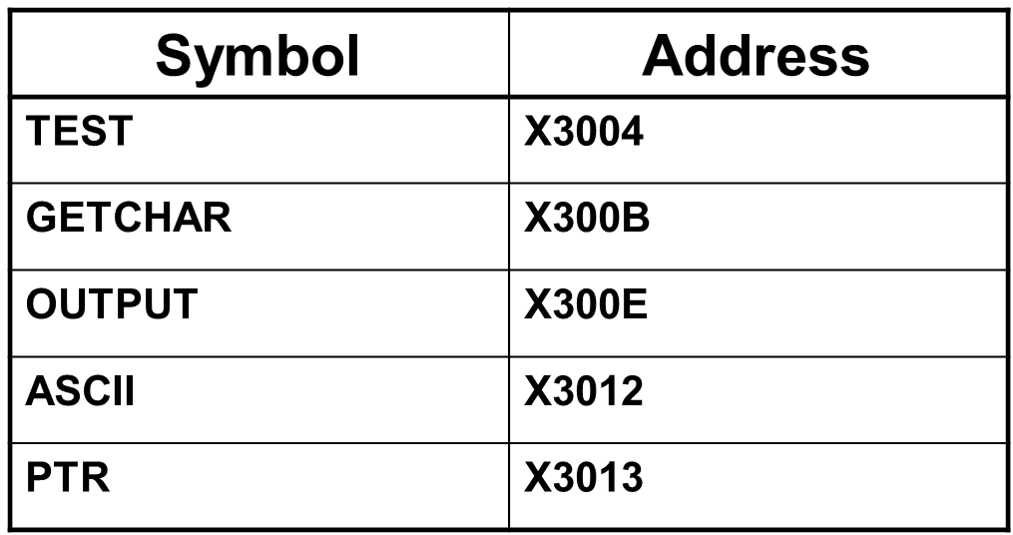
Symbol Table
Like assembler, compiler needs to know information associated with identifiers
  in assembler, all identifiers were labels and information is address
  Symbol table kept track of the addresses of the labels
Compiler keeps more information
Name (identifier)
Type
Location in memory
Scope
Name | Type | Offset | Scope
scale | int | 0 | global
number | int | 0 | main
value | int | -1 | main
temp | int | -2 | main
x | int | 0 | square
y | int | -1 | square

Slide 13
Implementing C: Translation from C to Assembly
Translate C to assembly
  Translating operations is the easy part
  Y = A*B is: MULT R3, R1, R2
Implement concept of scope
Concept of storage class
  Static, Auto, Register….
Pointers
Function calls
  Passing arguments to functions
…HOW ?
Starting point (Today): How are C variables allocated to memory ?....Run-time Stack

Slide 14
Translation: Allocation of Variables
What is compiler's task?
Allocate memory for variables in a systematic way.
Will build a symbol table to keep track of variable type,
size, location.
Generate instruction sequences that carry out the computations specified by operators and statements.
For this class, we will compile "by hand" to get a sense of how these translations occur.

Slide 15
Defining a variable in C
Identifier: references to this, translate to locations
  Name of the variable
  Example: itslocal
Type: gives us information on data representation and space needed
  Type of variable such as int, float, char…
  Example: int itslocal
Scope
  Where can it be accessed
  Example: global variable itsglobal
Storage Class
  How does C compiler allocate the storage
    Does value persist or not
  Two main classes in C: Automatic and Static

Slide 16
Scope: Global and Local
Where is the variable accessible?
Global: accessed anywhere in program
Local: only accessible in a particular region
Compiler infers scope from where variable is declared
  programmer doesn't have to explicitly state
  Symbol Table constructs this information
Variable is local to the block in which it is declared
  block defined by open and closed braces { }
  can access variable declared in any "containing" block
  Global variable is declared outside all blocks

Slide 17
Where can you put variables….?
Local variable inside a function（auto）
  Lasts only while the function is running
Local variable inside a function (static)
  Value persists throughout the life of the program
  persistance
Global variable visible to all functions within a file
Global variable visible in more than one file
Block scope – inside the block (defined by { } )

Slide 18
Types of Scopes
There are 4 types of scope
  Prototype Scope
    Just applies to prototypes
  File Scope
    Declared outside any function
  Function Scope
    only applies to labels!!!
  Block Scope
    includes function parameters

Slide 19
Scope vs. Lifetime
Scope Lifetime
File Scope Life of program
Block Scope Life of block
Can be overridden with “static”

Slide 20
Memory
Many languages have fixed mappings between scopes and lifetimes
In C, we have the option to decide...
  void foo(void) { int x;
  static int a;
  x = 42; …}
When the function goes away, x and its value go away since they were auto storage class (and placed on stack).
Setting a value into a static variable (e.g. a) means that the value is stored in a static area and will persist throughout the entire execution of the program

Slide 21
Storage Class: Automatic Variables
Local variable inside a function (lasts only while the function is running)
auto keyword (never used!)
Located on stack
Storage Class: AUTO

Slide 22
Static Variables (II)
static
  Initialized to zero (like global)
Located in static area
Value persists !
  Example: foo being called second time
Storage Class: STATIC

Slide 23
Static Variables (III)
Global variable visible in more than one file
Declared outside of any function in one file
Declared extern in other files (or functions/blocks)
Located in static area
Storage Class: STATIC

Slide 24
Confused?
int x;
static int y;
int main()
{
static int z; int w;
...
Static?
auto?

Slide 25
auto
int foo(int z)
{
int x;
...
if(x == z)
{
int y;
y = ...
auto variables (implicitly)

Slide 26
Static Initialization
void foo(void)
{
int x = 10;
static int y = 20;
printf(“x = %d y = %d\n”, x, y); y += 30;
}
What prints the first time foo is called?
What prints the second time?

Slide 27
Scope can be global within a file
These are different variables with Global scope within their respective files
static int i; static int i;
int main()
{
...
}
int foo(...)
{
...
}
int bar(...)
{
...
}
int baz(...)
{
...
}

Slide 28
Scope can be global across all files
int i;
extern int i;
void f() { extern int i;
...
...
}
These are the same variable!

Slide 29
Other goodies
register
  Suggests to compiler that this variable should be kept in a register
  Cannot get address of variable declared register
  Not as important as it once was with modern compilers
volatile
  Type qualifier
  Tells compiler that value in this variable may change on its own!
  Used in
    shared memory applications
    Memory mapped I/O
…

Slide 30
Storage Class Specifiers
register auto static
const
extern
volatile
Type Qualifiers
33
Volatile: "这个变量的值可能会在程序控制之外被改变，不要对这个变量进行优化假设。"

Slide 31
Allocation of Variables in Memory and enforcing Scoping rules
Simply assigning a memory location for each variable may not be enough to enforce scope
Need a better scheme to allocate high level program variables to memory in the processor
  Scope
  Storage class
  Allocate space to a variable

Slide 32
Mapping C variables to Memory:
Allocating variables in Memory
How to allocate memory
locations to variables
  Enforce scope
Low Memory
High Memory
x0000
xFFFF

Slide 33
Compiling & Executing C programs: The Run-time Stack
THIS is the key….

Slide 34
Memory Representation
Our convention will be that "high-memory" will be on the bottom and "low-memory" on top.
  drawings are not to scale
x0000
Low Memory
High Memory
xFFFF

Slide 35
Typical Arrangement
Normally the actual program code (executable instructions) is placed in low memory
  Operating System and boot code usually in lowest mem area
x0000
Code
xFFFF

Slide 36
Typical Arrangement
Next we have an area for storage of constant data
x0000
Code
Constant Data
xFFFF

Slide 37
Typical Arrangement
Data that may be changed follows
x0000
Code
Constant Data
Alterable Data
xFFFF

Slide 38
Typical Arrangement
Code
Constant Data
Alterable Data
x0000
Static
These three items comprise what is considered the static area of memory. The static area details (size, what is where, etc.) are known at translation or compile time.
xFFFF

Slide 39
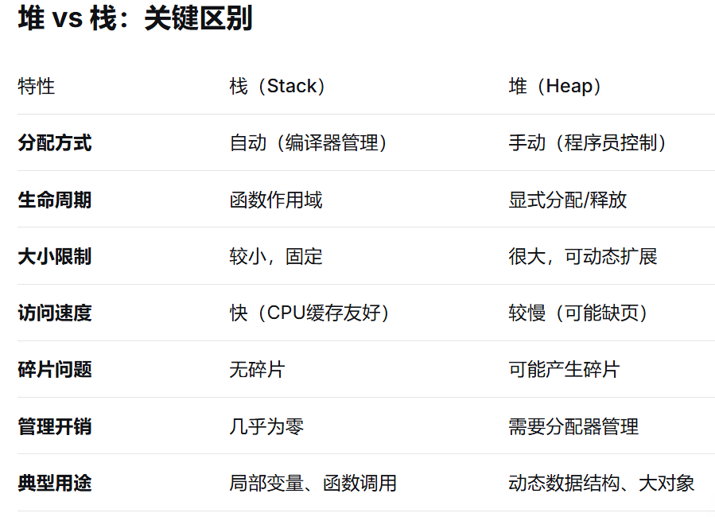
Typical Arrangement: Heap
Code
Constant Data
Alterable Data
Heap
x0000
Static
Immediately above the static area the heap is located.
The heap can expand upward as the program dynamically requests additional storage space
  malloc()
In most cases, the runtime environment manages the heap for the user
xFFFF
堆是程序动态内存管理的关键区域，与栈（Stack）形成互补的内存管理模型。
堆中对象的生命周期由程序员显式控制，不受函数调用栈限制。
堆空间通常比栈大得多（栈通常几MB，堆可达GB级）

Slide 40
Typical Arrangement: stack for local variables
Finally, the activation stack starts in high memory and can grow down as space is needed.
Items maintained in the stack include
  Local variables
  Function parameters
  Return values
x0000
Code
Constant Data
Alterable Data
Heap
Stack
Static
xFFFF

Slide 41
auto variables
auto, short for automatic variables are those that exist on the stack. The auto keyword is not normally used.
Automatic means that space is allocated and deallocated on the stack automatically without the programmer having to do any special operations.
Code
Constant Data
Alterable Data
Heap
Stack
x0000
Static
Dynamic
xFFFF

Slide 42
Summary of Typical Arrangement
These items in the upper portion of the memory change* during execution of the program.
Thus they are called dynamic
Code
Constant Data
Alterable Data
Heap
Stack
x0000
Static
Dynamic
*Not just their value

Slide 43
Compiler Magic
The compiler has the job of converting your C program into assembly code
Thus it must convert the symbolic variable names into addresses
How does it keep track of what is where?
  Keep track of scope
  Storage class
Symbol table provides much of this information

Slide 44
Activation Records!!!
Two main areas (for now) in memory:
  Global data section
  Run-time stack
Local variables exist only during lifetime of function
  De-allocated after function completes
How to define area of memory for a code block/function ?
......Activation Record
  Also called Stack Frame
  Local variables allocated in the activation record
  Activation record is portion of run-time stack
    Function can only access a valid portion of the stack
    Should not access another functions activation records!
  When function returns…POP the record
    The local variables can no longer be accessed!

Slide 45
Symbol Table
For each variable keeps track of
  Type
  Scope
  Location (as an offset)
    Either in global area or local area
    If in local area, then based on activation record
  Other info (const, etc.)

Slide 46
Symbol Table
Like assembler, compiler needs to know information associated with identifiers
  in assembler, all identifiers were labels and information is address
  Symbol table kept track of the addresses of the labels
Compiler keeps more information
  Name (identifier)
  Type
  Location in memory
  Scope
Name | Type | Offset | Scope
scale | int | 0 | global
number | int | 0 | main
value | int | -1 | main
temp | int | -2 | main
x | int | 0 | square
y | int | -1 | square

Slide 47
Offset?
Assembly code written by a compiler usually looks a little different from assembly code written by hand
Registers are dedicated to point to key areas of memory
R4 is the Global Pointer
  Points to start of global static area
Code
Constant Data
Alterable Data
Heap
Stack
x0000
R4
xFFFF

Slide 48
Keeping Track of auto variables
Stack pointer is obvious but the compiler writer needs more info...
Where is the activation stack frame?
Code
Constant Data
Alterable Data
Heap
Stack
x0000
R4
R6 is Top of Stack (TOS) pointer
R6
xFFFF

Slide 49
Why do we care?
We would like to know where a variable is throughout the execution of a function
Can reference the variable from the stack pointer only
Code
Constant Data
Alterable Data
Heap
Stack
x0000
R4
R6
xFFFF

Slide 50
Can we use TOS
What do we need to keep track of?
int f(int a, int b) {
int c;
c = a + b;
return c;
}
int main() { int x;
int y = 4;
x = f(7, y);
printf("%d\n", x);
return 0;
}

Slide 51
Frame Pointer
The Frame Pointer designates a fixed spot in the activation stack which can be used as a reference throughout execution of the function.
Code
Constant Data
Alterable Data
Heap
Stack
x0000
R4
Note: Frame pointer also called dynamic link
Store Frame pointer in register….R5
  Points to ‘start’ of set of local variables
R6
R5
xFFFF

Slide 52
LC3: Local Variable Storage
LC3: Local Variable Storage
Local variables are stored in an
activation record, for each code block also known as a stack frame.
  Cannot afford to forget about the Stack ©
temp
value
number
Symbol table “offset” gives the distance from the base of the frame.
  R5 is the frame pointer – holds address of the base of the current frame.
  A new frame is pushed on the
run-time stack each time a block is entered.
  Because stack grows downward,
base is the highest address of the frame, and variable offsets are <= 0.
R5

Slide 53
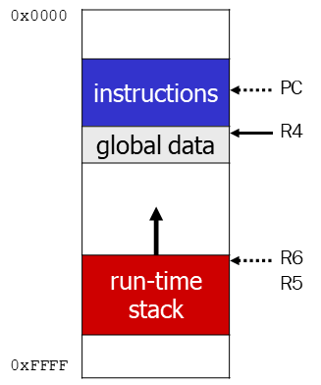
Summary: LC3 Allocation for Variables
Global data section
  All global variables stored here (actually all static variables)
  R4 points to beginning
Run-time stack
  Used for local variables
  R6 points to top of stack
  R5 points to top frame on stack
  New frame for each block
  (goes away when block exited)
Offset = distance from beginning of storage area
  Global: LDR R1, R4, #4
  Local: LDR R2, R5, #-3

Slide 54
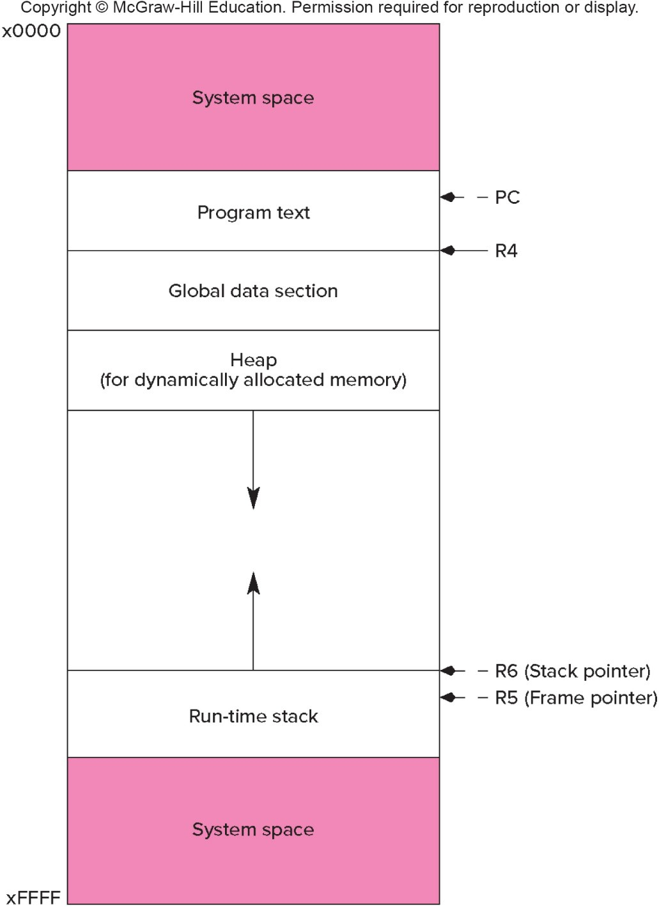
LC-3 Memory Map – The Complete Picture
The LC-3 operating system reserves some of the memory address space for trap vectors, service routine code, and memory-mapped I/O.
Program instructions will be placed in the "program text" section.
Global variables are allocated next. R4 is set to the first allocated address for globals.
Local variables are stored on the run-time stack. R5 points to the local variables of the currently- executing function.

Slide 55
Variables and Memory Locations
In our examples, a variable is always stored in memory.
When assigning to a variable, must store to memory location.
A real compiler would perform code optimizations that try to keep variables allocated in registers.
  Why?

Slide 56
Example: Compiling to LC-3
#include <stdio.h> int inGlobal;
main()
{
int inLocal; /* local to main */
int LocalA, LocalB;
/* initialize */
inLocal = 5;
inGlobal = 3;
/* perform calculations */
LocalA = ++inLocal;
LocalB = inLocal & ~inGlobal ;
/* print results */
printf("The results are: LocalA = %d, LocalB =%d\n",LocalA, LocalB);
}

Slide 57
Example: Symbol Table
Name | Type | Offset | Scope
inGlobal | int | 0 | global
inLocal | int | 0 | main
LocalA | int | -1 | main
LocalB | int | -2 | main

Slide 58
Example: Code Generation
; main
; initialize variables
AND R0, R0, #0
ADD R0, R0, #5 ; inLocal = 5
STR R0, R5, #0 ; (offset = 0)
AND R0, R0, #0
ADD R0, R0, #3 ; inGlobal = 3
STR R0, R4, #0 ; (offset = 0)
; first statement:
; LocalA =++inLocal;
;address of inLocal = R5 + #0
Address of localA = R5 + # -1
LDR R0, R5, #0 ; get inLocal
ADD R1, R0, #1 ; increment
STR R1, R5, #-1 ; store localA

Slide 59
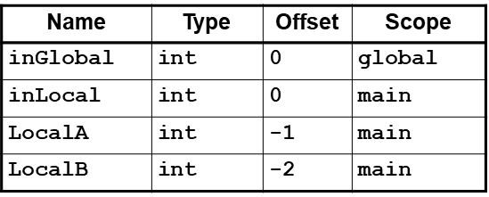
Example (continued)
; second statement:
; LocalB = inLocal & ~inGlobal;
address of inGlobal= R4+ #0
; previous code segment left
; inLocal value in R0
LDR R1, R4, #0 ; get inGlobal
NOT R1, R1 ; Not inGlobal
AND R2, R0, R1 ; inLocal & ~inGlobal
STR R2, R5, #-2 ; store in LocalB
; (offset = -2)

Slide 60
Example
1 #include <stdio.h>
2 int main(void)
3 {
4 int amount; // The number of bytes to be transferred
5 int rate; // The average network transfer rate
6 int time; // The time, in seconds, for the transfer
7 int hours; // The number of hours for the transfer
8 int minutes; // The number of mins for the transfer
9 int seconds; // The number of secs for the transfer
10
11 // Get input: number of bytes and network transfer rate
12 printf("How many bytes of data to be transferred? ");
13 scanf("%d", &amount);
14 printf("What is the transfer rate (in bytes/sec)? ");
15 scanf("%d", &rate);
16
17 // Calculate total time in seconds
18 time = amount / rate;
19
20 // Convert time into hours, minutes, seconds
21 hours = time / 3600; // 3600 seconds in an hour
22 minutes = (time % 3600) / 60; // 60 seconds in a minute
23 seconds = ((time % 3600) % 60); // remainder is seconds
24
25 // Output results
26 printf("Time : %dh %dm %ds\n", hours, minutes, seconds);
27 }
Figure 12.4 A C program that performs a simple network rate calculation.

